Slide 1

Simple Linear Regression

Slide 2
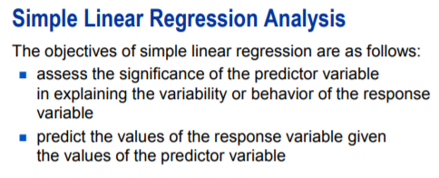
Simple Linear Regression

Slide 3
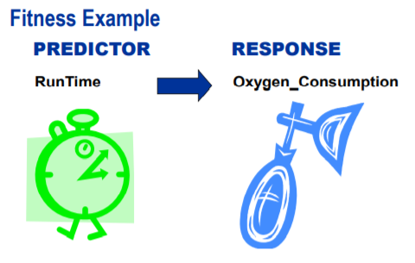
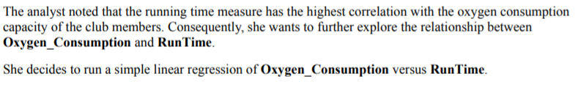
Simple Linear Regression

Slide 4
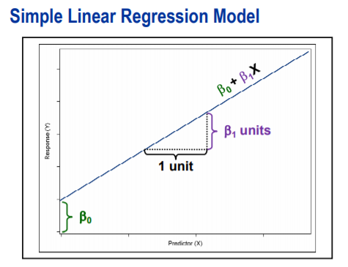
Simple Linear Regression

Slide 5
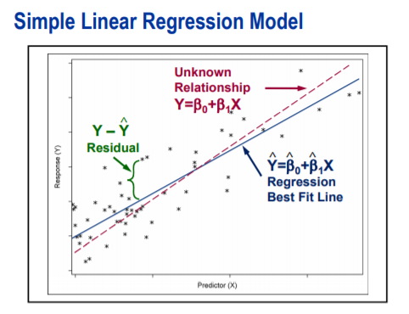
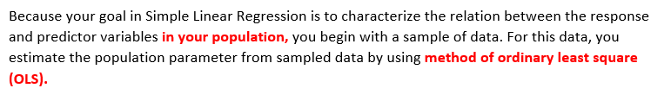
Simple Linear Regression

Slide 6
Simple Linear Regression
OLS method provides the parameter estimates by determining the line that minimize the sum of squared distances between the observations and fitted line. In other words, fitted regression line is as close as possible to actual data.
The method provides the estimates with certain optimum properties. If the assumptions are valid, the least square estimates are unbiased estimates of population parameter and have minimum variance (efficiency). The least square estimates often called BLUE (Best Linear Unbiased Estimates).
With a large and representative sample, fitted regression line is a good approximation of the relationship between response and predictor variables in population.

Slide 7
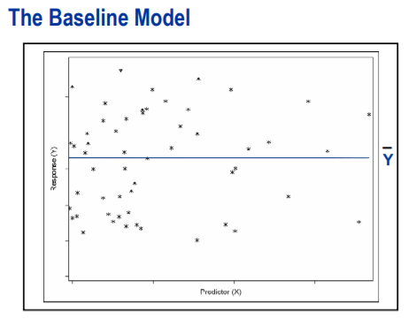
Simple Linear Regression
The baseline Model is a horizontal line across all the values or predictor variable. The slope of the line is 0 and intercept is sample mean of response variable.
The Simple Linear Regression Model is compared against baseline model to determine whether predictor variable is explaining significant variability in response variable.
In a baseline model, there is no association between response and predictor variable so knowing the value of predictor variable doesn’t improve the prediction.

Slide 8
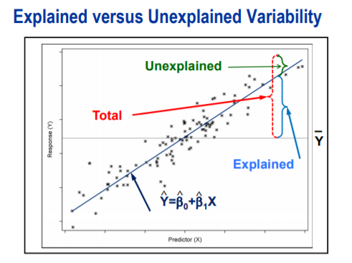


Simple Linear Regression
To determine Simple Linear model is better than Baseline Model, compare the explained variability to unexplained variability.
Explained Variability is related to difference between regression line and mean of response variable.
Unexplained Variability is related to difference between observed value of response variable and predicted value response variable.

Slide 9

Simple Linear Regression
To determine Simple Linear model is better than Baseline Model, compare the explained variability to unexplained variability.
Explained Variability is related to difference between regression line and mean of response variable.
Unexplained Variability is related to difference between observed value of response variable and predicted value response variable.
Total Variability is related the observed value of response variable and mean of response variable.

Slide 10
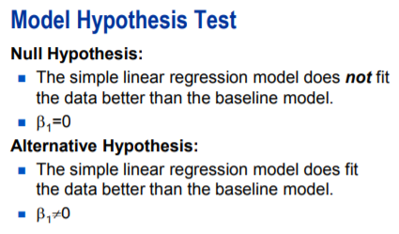
Simple Linear Regression
If the estimated simple linear regression model does not fit the data better than baseline model, you fail to reject the null hypothesis. Thus, you do not have enough evidence to say that the slope of the regression line in the population is different from zero.
If the estimated simple linear regression model does fit the data better than baseline model, you reject the null hypothesis. Thus, you do have have enough evidence to say that the slope of the regression line in the population is different from zero and that the predictor variable explains the significant amount of variability in the response variable.

Slide 11
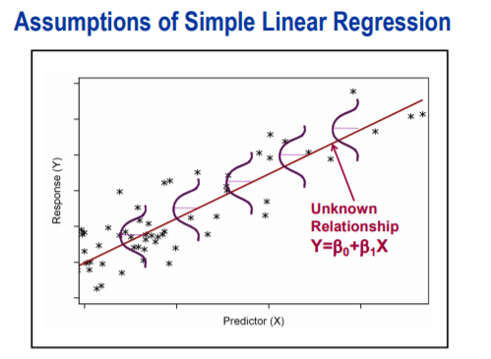
Simple Linear Regression
One of the assumption of simple linear regression is that mean of the response variable is linearly related to predictor variable. In other words, a straight line connects the means of the response variable at each value of predictor variable.
The other assumptions are exactly same as ANOVA that is error term is normally distributed and has a constant variance and observations are independent.

Slide 12
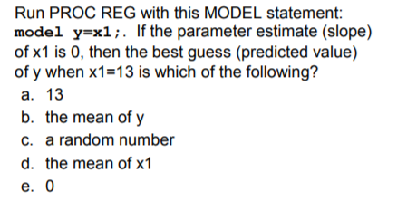
Simple Linear Regression

Slide 13

DEMO

Slide 14
Q&A

